Slide 1
INTERFACE MOCK-UP
Created by Robert Schulz

Slide 2
ABOUT/TOPIC
Project Name: “Akita Memoirs Museum”
About: This museum about the memories about the Akita dogs and their loyal acts. Mainly it’s the story of the famous Hachiko which was a brilliant story for people to read and visit.

Slide 3
PURPOSE & GOAL
The goal and purpose of Akita Memoirs Museum is to provide people who want to see a website based on the great story of an amazing and loyal dog from japan.

Slide 4
TARGET AUDIENCE
Gender: Male and Females
Age: 18+
Income: $20,000-$50,000
Interests: Dog Lovers

Slide 5
STYLE GUIDE
Color Scheme: Happy Spring Colors
Sky blue: #7EC0EE (126,192,238)
Sun Yellow: #FDB813 (253, 184, 19)
Forest Green: #228B22 (34,139,34)
Font: Brush Script Size:60 header
Font: Brush Script Size:30 Buttons
Font: Centaur Size:18 Content
Images on left side with content on right for home page. Each page will only be viewed by the main content box instead of loading a new page.

Slide 6
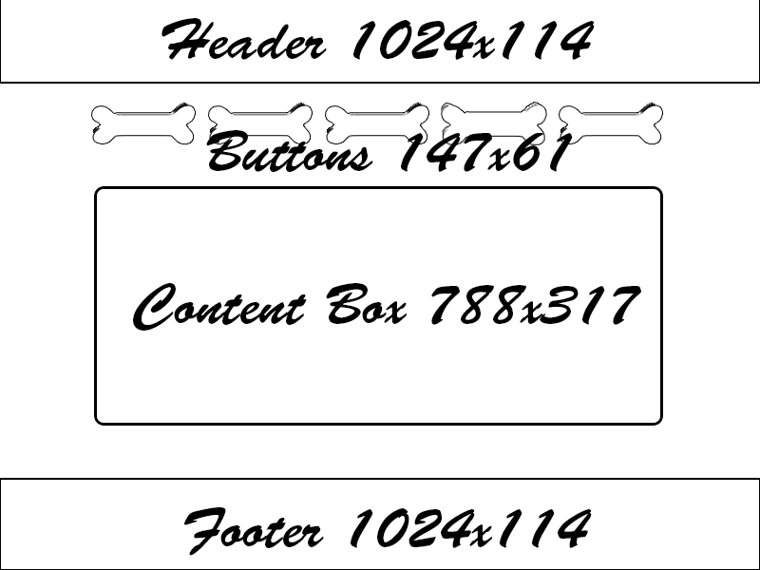
WIREFRAME SCOPE

Slide 7
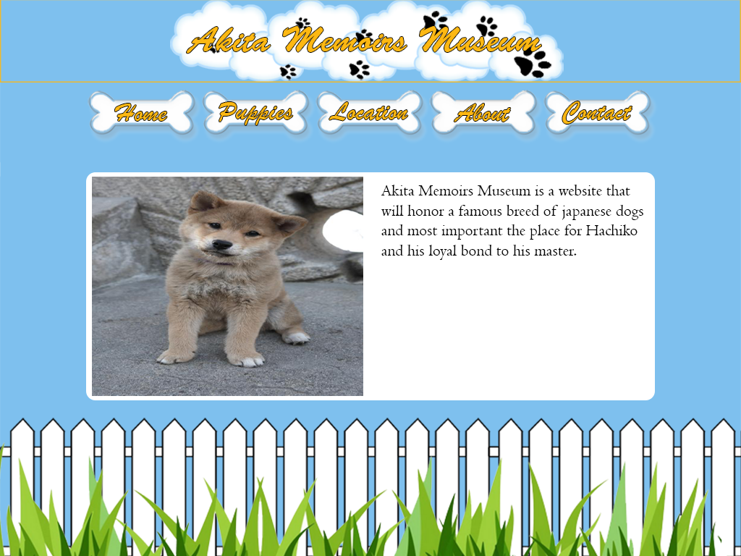
MOCK-UP

